Slide 1
Data Visualisation 4
2024-2025 Using Pandas for Data Processing (P2)
by Dr Yuhang Ye

Slide 2
TOC
Data Preprocessing (Cleaning and Filling)
Filtering
Normalization and Transformation
Binning

Slide 3
Data Preprocessing
Cleaning and Filling

Slide 4
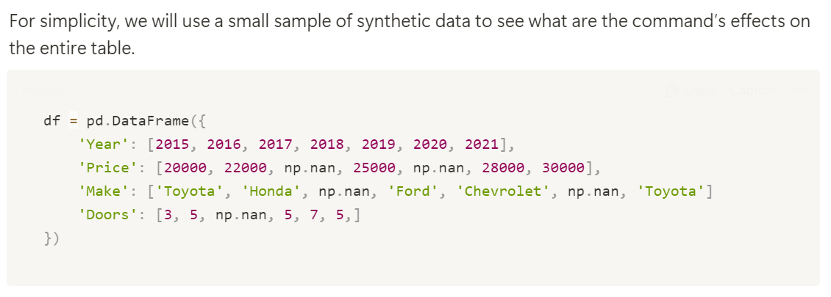
Look at a synth data

Slide 5
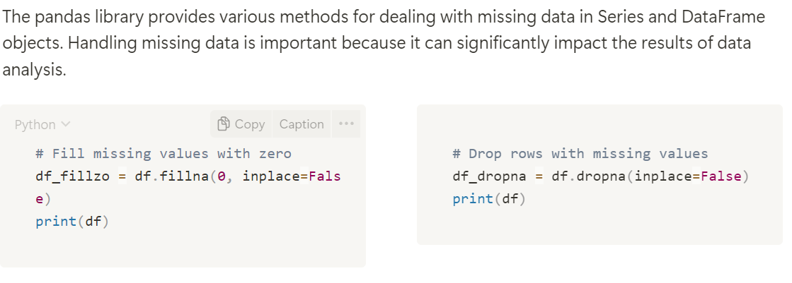
Handling Missing Data (General Strategy)
Default{axis=0} -> index
Note: By default, the df.fillna and df.dropna function creates a copy of the DataFrame and fills the missing values in the copy. If you want to modify the original df directly, set the parameter inplace=True. When inplace=False (the default), the function returns a new DataFrame with the changes, leaving the original df unchanged.

Slide 6
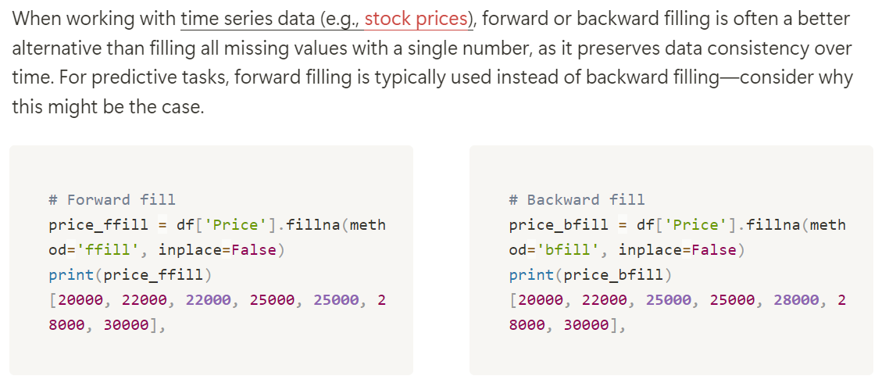
Filling Missing Values with Forward or Backward Fill

Slide 7
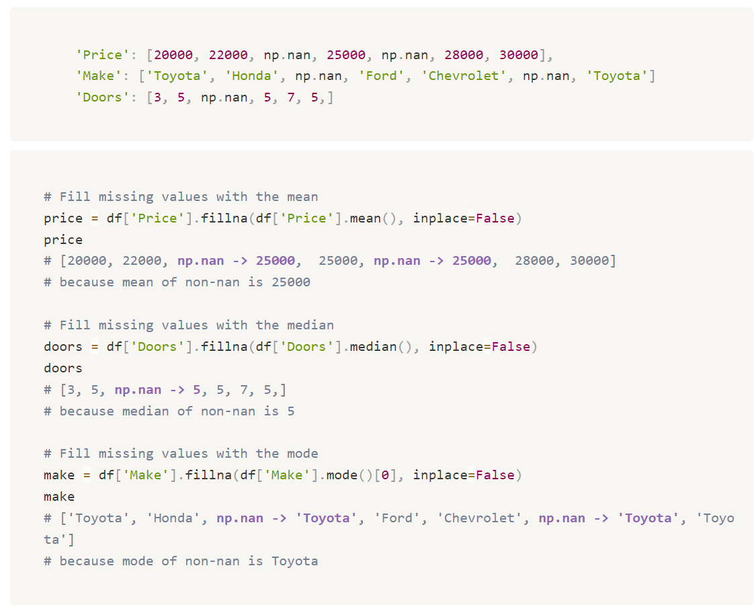
Filling with the Mean, Median, or Mode
Here’s a tip: For different types of data, it's important to use the appropriate method to fill missing values.
For nominal data like "Make" (e.g., the brand of the car), using the mode is a good choice, as it fills in the most frequent category.
For discrete data like "Doors" (which represent a count of car doors), using the median is often more appropriate since we are unlikely to have 2.5 doors after average.
Lastly, for quantitative data like "Price," the mean is commonly used because it provides an average that represents the overall dataset well.

Slide 8
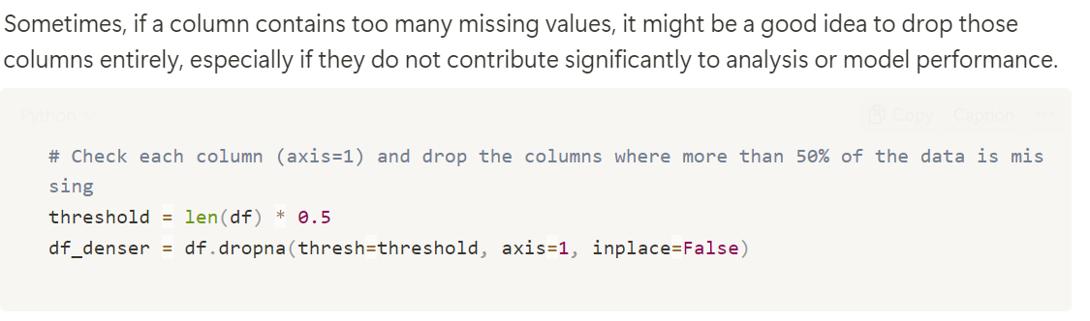
Conditional Drop Columns
It means for all samples, an attribute is less recorded, should be dropped

Slide 9
Filtering
Select Rows (Samples) according to Your Needs

Slide 10
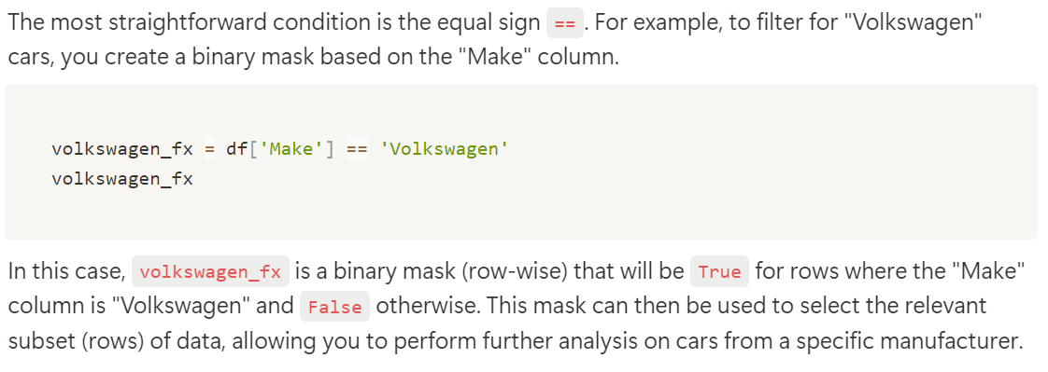
Equality Condition

Slide 11
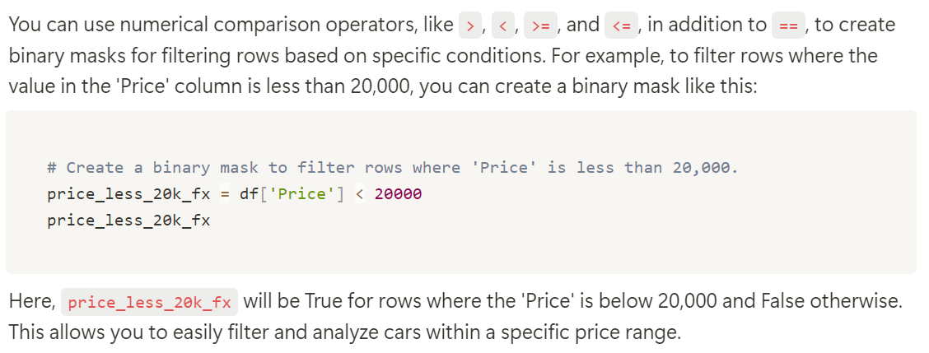
Inequality Condition

Slide 12
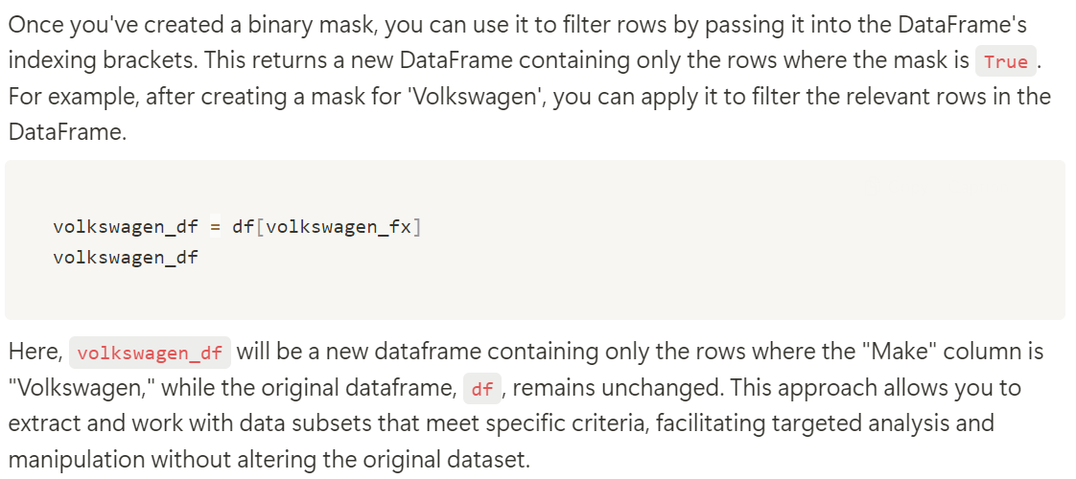
Use of Binary Mask to Filter Rows

Slide 13
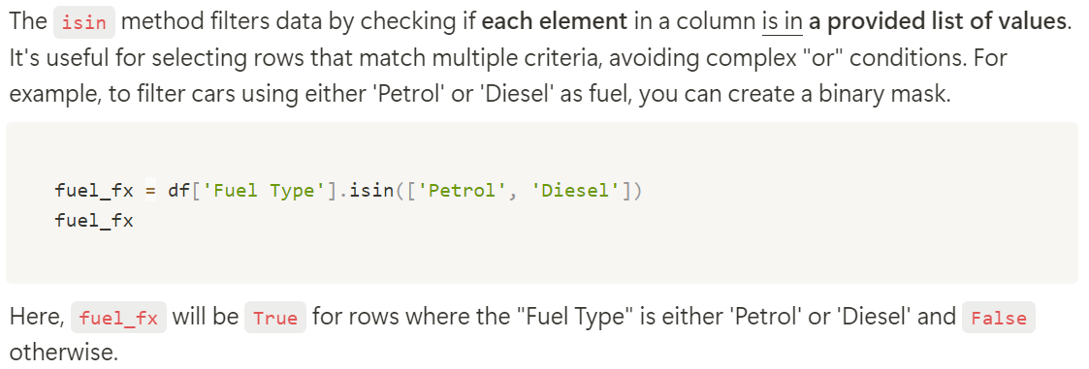
Membership Checks

Slide 14
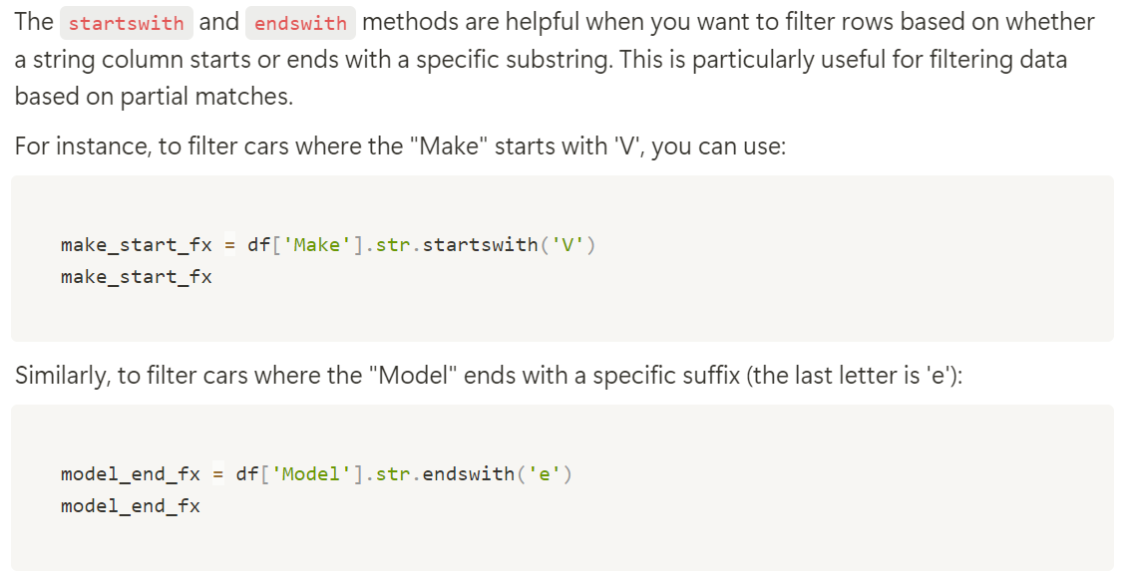
Simple String Matching

Slide 15
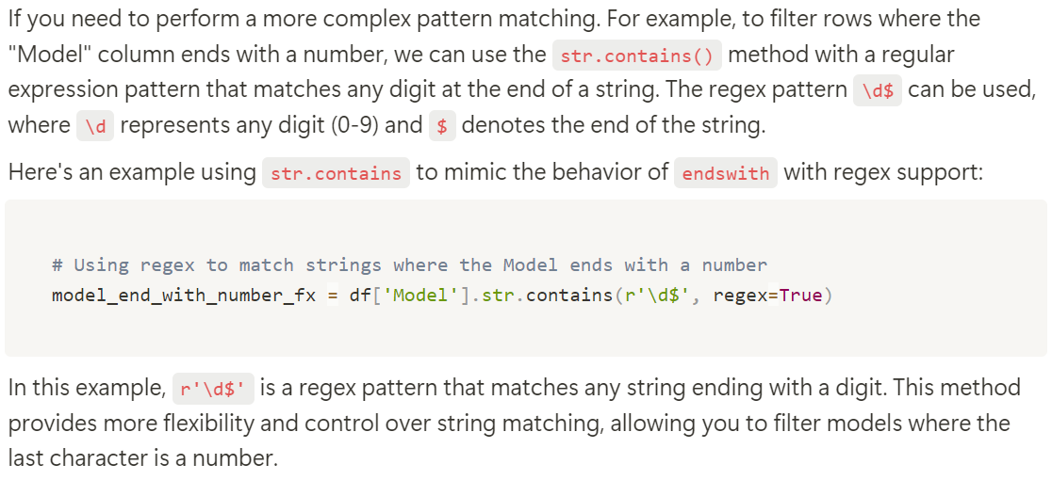
Pattern-based String Matching

Slide 16
Normalization and Transformation

Slide 17
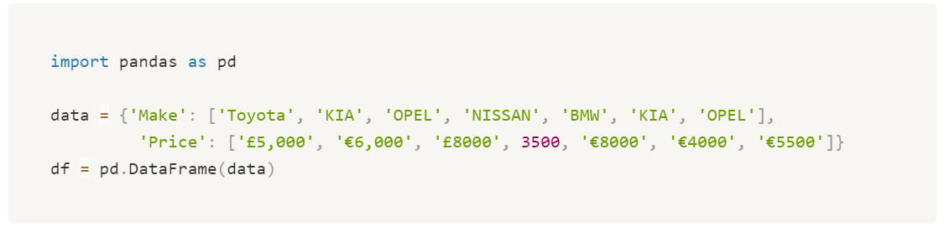
Synth Data
In data analysis, applying functions to dataframe columns is common for transformations, calculations, or format adjustments. This section covers using Pandas' .apply method for data normalization and simple transformations.
We are coding on a synth data to standardize prices in the 'Price' column from various formats to euros.

Slide 18
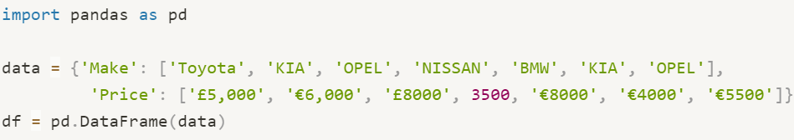
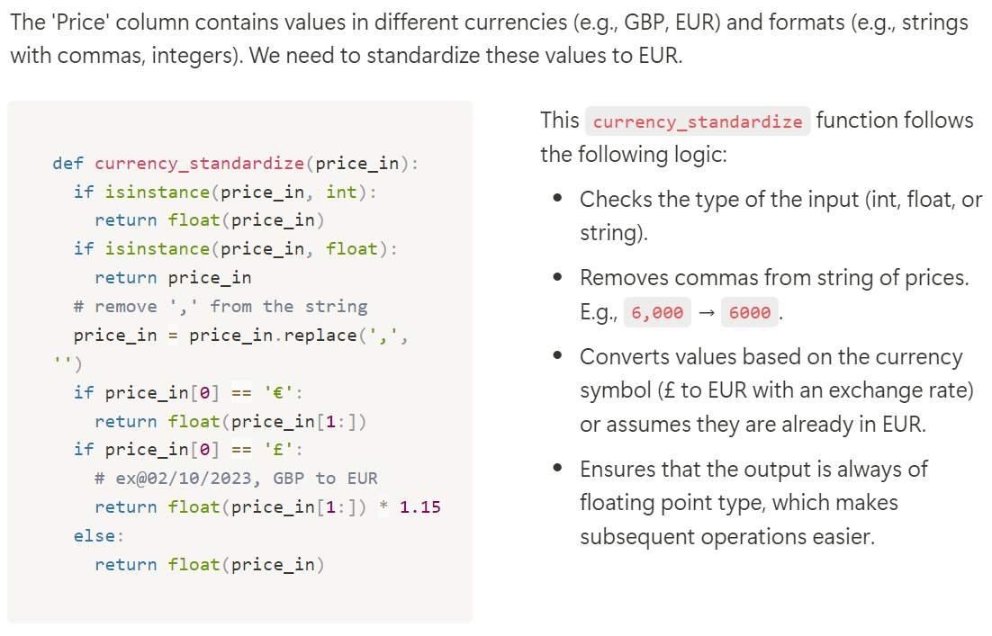
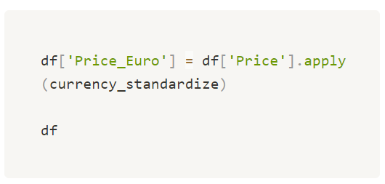
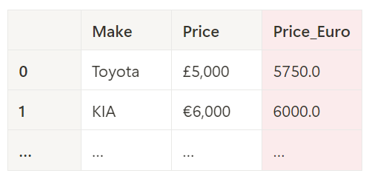
Apply a Function on Each Cell in a Single Column
Single column (Series)
We design a function what works for a single cell input

Slide 19
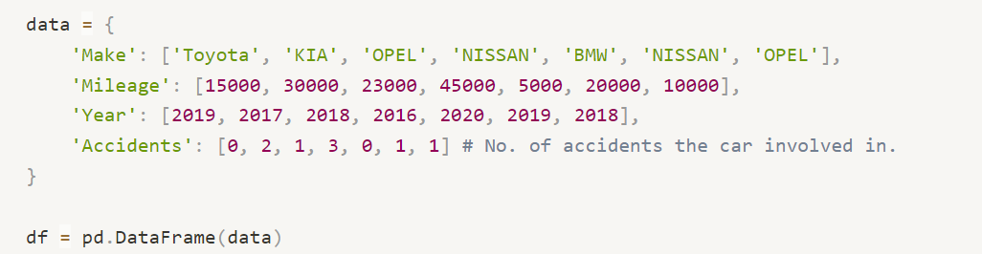
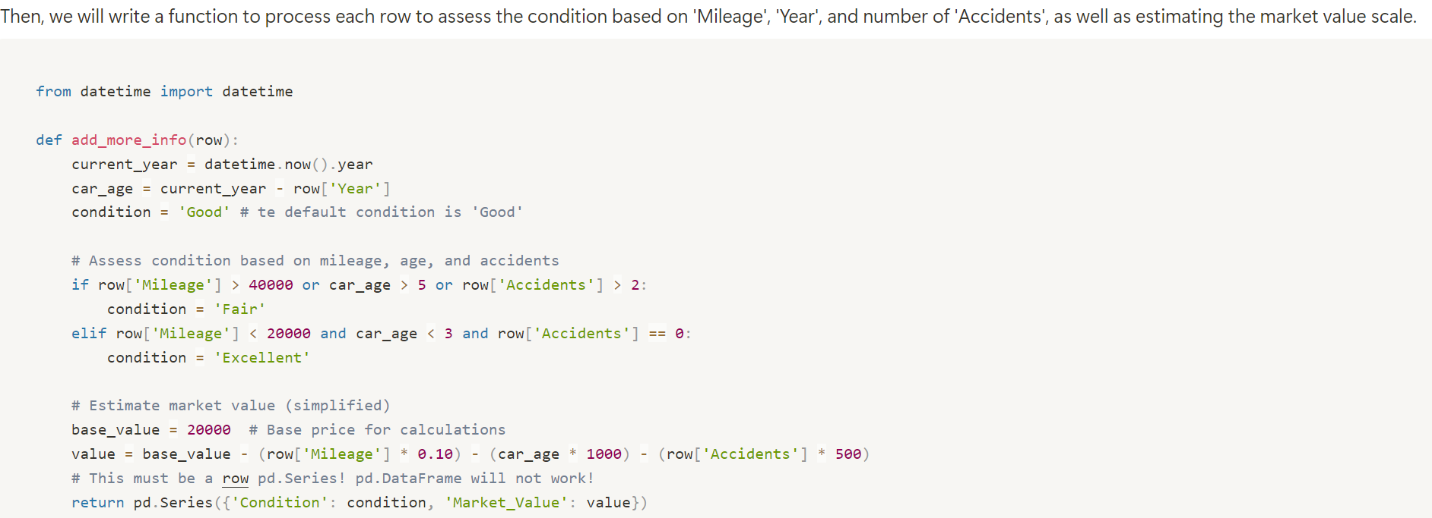
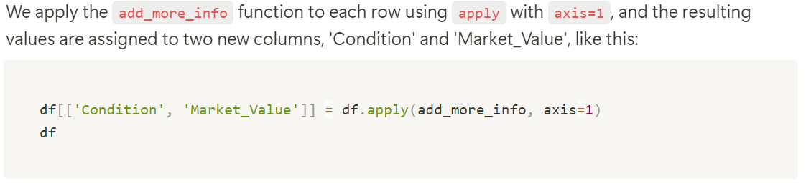
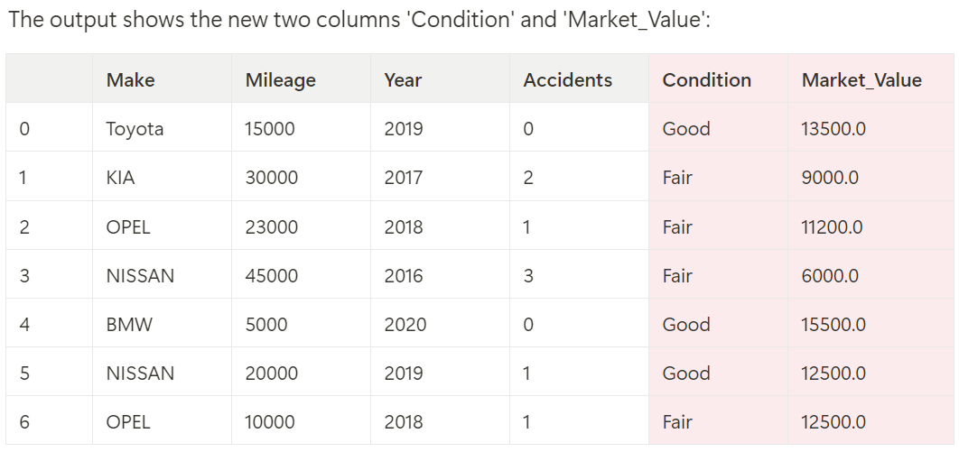
Apply a Function on Each Row (Multiple Columns)
Axis=1: row-wise
Input: a row; Output: a new row with 2 columns
Note: .apply() will aggregate all output new rows into a dataframe

Slide 20
Binning
When working with continuous data like price or discrete data with many distinct values like age, grouping values into ranges, or "binning," can simplify analysis.

Slide 21
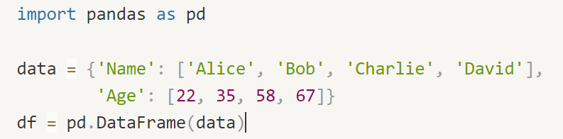
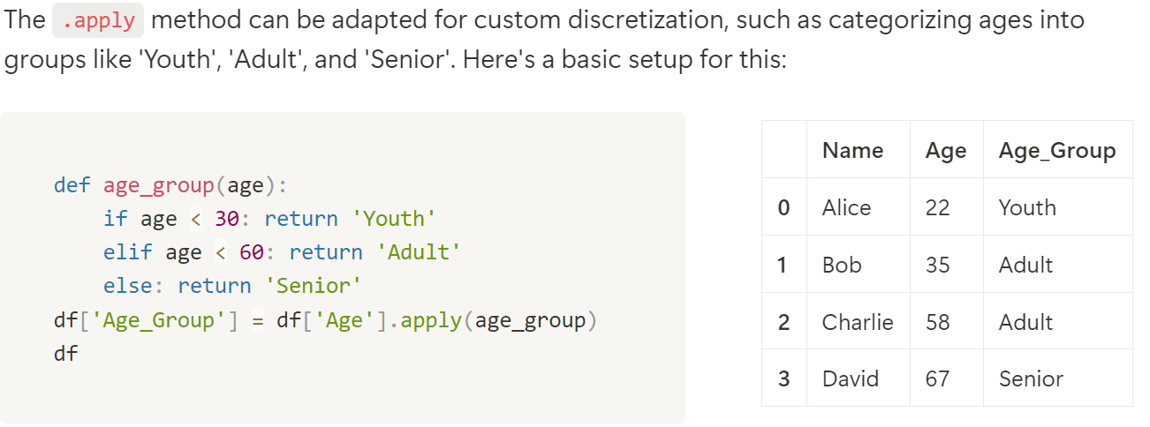
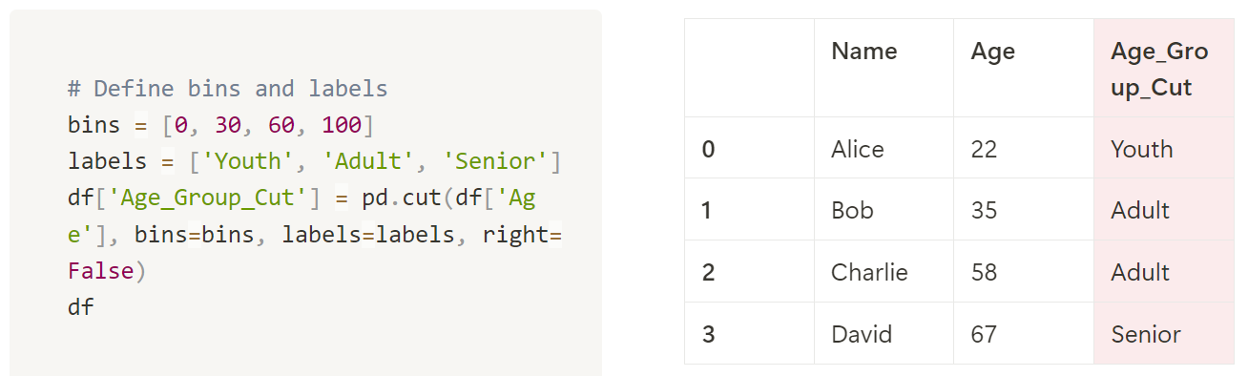
Customized Discretization
The code demonstrates how to use Pandas' .cut function to automatically bin numerical data into defined intervals. In this example, the bins list defines the age ranges [0-30), [30-60), and [60-100) as the intervals. The right=False parameter ensures that the bin intervals are left-inclusive, meaning the right edge is excluded from each range. The labels list assigns corresponding category names: 'Youth', 'Adult', and 'Senior'. The pd.cut function then segments the 'Age' column into these bins, and the results are stored in a new column, 'Age_Group_Cut'. For instance, an age of 22 is categorized as 'Youth', while 35 and 58 fall into the 'Adult' category, and 67 is classified as 'Senior'.

Slide 22
Data Viz 4
Thank You

